Slide 1

Next word prediction using lstm Poojith Mendem deva Priya Mankena

Slide 2
Introduction
Next-word prediction uses NLP techniques to suggest the most likely word to follow in given text.
It is used in tools like auto-complete, speech recognition, and translation.
Older models, like simple RNN, struggle to understand long-term context in text
This project uses Long Short-Term Memory (LSTM) networks, which are better at remembering context.

Slide 3
Preprocessing
Data Collection
Shakespeare’s Hamlet
Tokenization
4818 unique tokens
Vector Representation
Subsequence vectors
Splitting
Each line uses all but the last word as
independent variable and the last word
as the dependent variable, iteratively
applied across the entire text.
Subsequence vectors
Brevity is the soul of wit
Brevity is
Brevity is the
Brevity is the soul
Brevity is the soul of
Brevity is the soul of wit

Slide 4
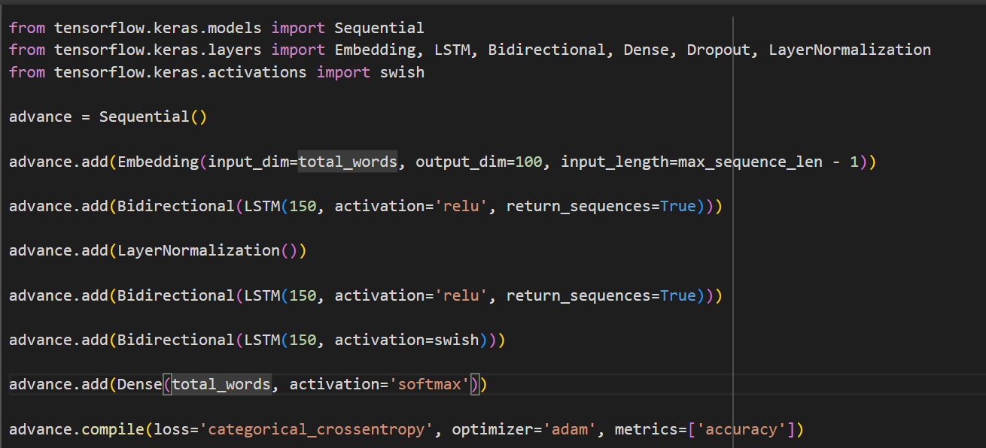
Model building
Embedding
100 dimension
Input layer
150 neurons
Hidden layer
3 bi-directional layers with activation function as ReLU and Swish
Output layer
4818 neurons with softmax
Compilation
Loss – categorical crossentropy
Optimizer – adam
Metrics- accuracy

Slide 5
Improvements
Simple RNN struggles with vanishing gradients, making it less effective for long sequences.
LSTM mitigates this issue with gating mechanisms (input, forget, output gates), enabling better handling of long-term dependencies.
Bidirectional LSTM further improves performance by processing the text in both forward and backward directions, capturing richer contextual information for more accurate predictions.

Slide 6
REsults
Model | Accuracy | Loss
Simple RNN | 43.02 | 2.50
LSTM | 60.81 | 1.69
Bi-directional LSTM | 83.47 | 0.56
The Bidirectional LSTM is the best model, achieving the highest accuracy (83.47%) and the lowest loss (0.56). It outperforms Simple RNN (43.02% accuracy, 2.50 loss) and LSTM (60.81% accuracy, 1.69 loss) by capturing context from both forward and backward directions, enabling more accurate next-word predictions.

Slide 7
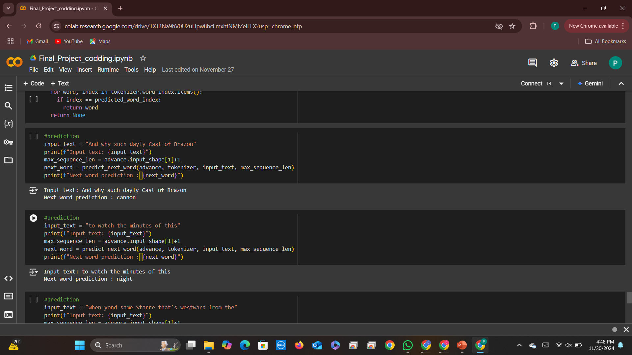
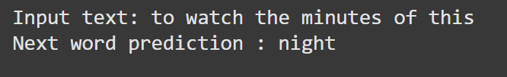
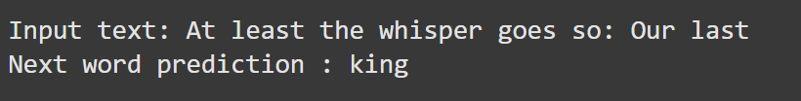
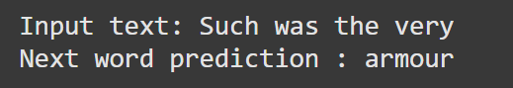
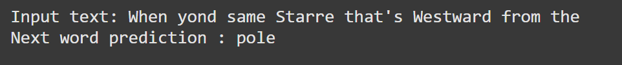
output

Slide 8
Future work
Training with More Data
Increase Epochs
Model Optimization
High-End Hardware

Slide 9

Thank you

